Slide 1
Cloud Computing
Presented by,
Team Theag

Slide 2
Table Of Content Elements
Architecture
Services
Model
Advantages
Disadvantage

Slide 3
Introduction
Definition
Key Feature
On-demand self-service, broad network access, resource pooling, rapid elasticity, measured service.
Cloud computing is the delivery of computing services—including servers, storage, databases, networking, software, analytics, and intelligence—over the Internet (“the cloud”).

Slide 4
Cloud Service Provider Characteristics
On-demand service
Resource Scalability
Pay-As-You-Go

Slide 5
Facilities
Hardware
Software
Storage
Databases
Backup Dtata Recovery
Video Streaming

Slide 6
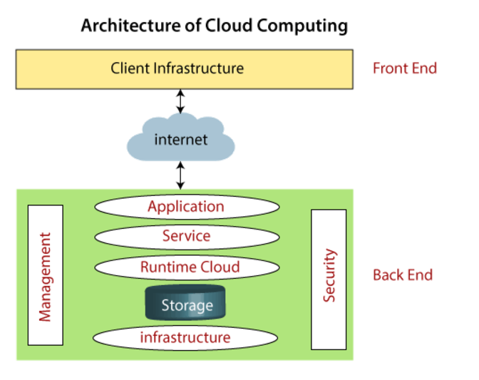
Architecture
1
Application
1
2
2
Service
3
Runtime Cloud
3
4
4
Storage

Slide 7
Leading Cloud Service Providers
Amazon Web Services (AWS)
1
Microsoft Azure
2
Google Cloud Platform (GCP)
3
Salesforces, Alibaba, Oracle
4

Slide 8
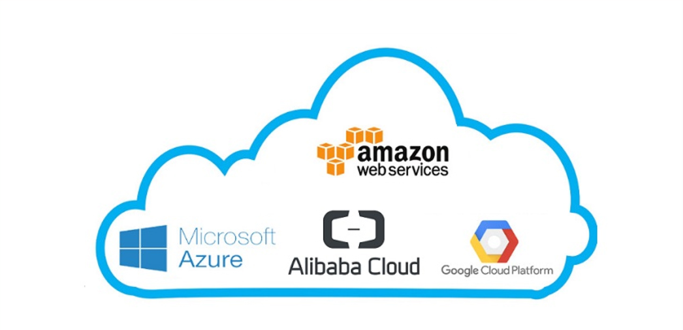

Slide 9
type of Services
It’s (software) Delivers software applications over the internet, accessible via web browsers or mobile devices.
It’s (Infrustructure) Provides virtualized computing resources like servers, storage, and networking.
It’s (platform) Offers a platform-API for developing and deploying applications, including tools and environments.
IaaS
PaaS
SaaS
AWS EC2
Google app engine, Azure
Google docs

Slide 10
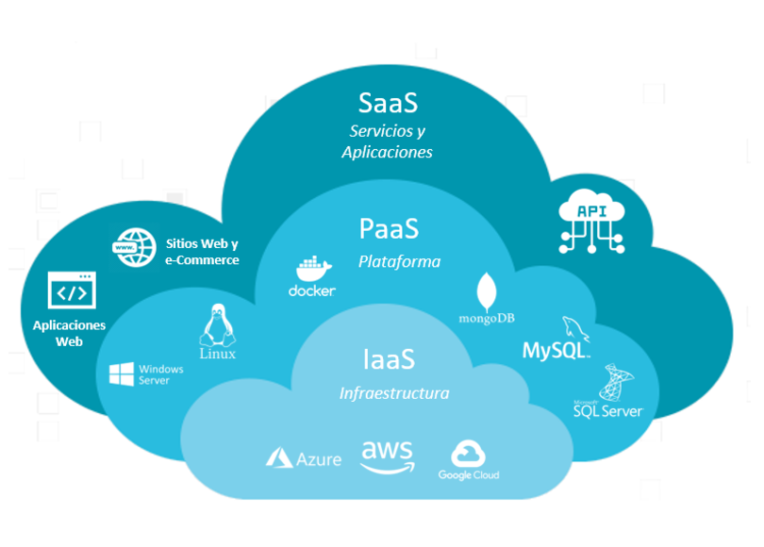

Slide 11
Cloud Model
Public Cloud
Services are provided over a shared infrastructure, accessible to the general public.
Community Cloud
Dedicated infrastructure managed by an community use.
Private Cloud
Dedicated infrastructure managed by an organization for its exclusive use.
Hybrid Cloud
Combines elements of both public and private clouds, providing flexibility and control.

Slide 12
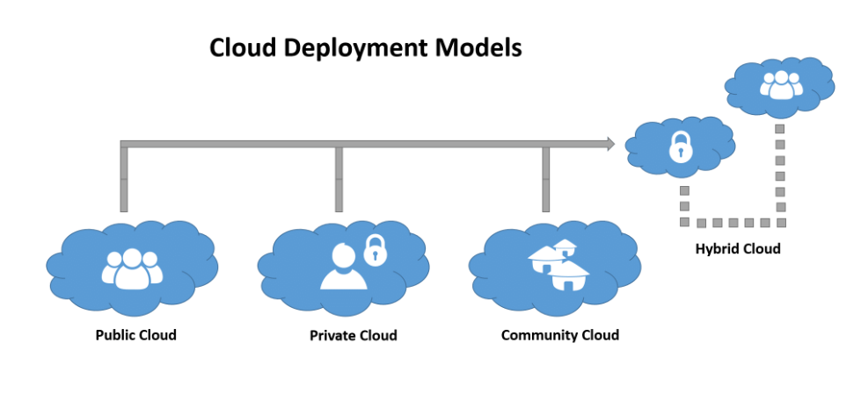

Slide 13
Advantage
Low Cost
Data Recovery
Auto Upgrade
Unlimited storage
Any time Any where
Easy for startup

Slide 14
Disadvantage
Security
Internet Connection
Uncontrolled Process

Slide 15
Thank you

Slide 16
Question on Cloud Computing Team Theag
Team Members:Redwan Bin Jalal(2101006),Atikur Rahman(2101040),Talha Zobaer(2101036)
Question 1:
A startup company, "MediSync," is developing a telemedicine platform to connect doctors with patients remotely. The platform requires secure video consultations, patient data storage, and real-time access to medical records. The company is considering adopting cloud computing to ensure scalability, data security, and seamless user experience while managing costs.
Define cloud computing and explain how "MediSync" can benefit from its key characteristics, such as scalability, reliability, and costefficiency, to enhance their telemedicine platform.
"MediSync" plans to use cloud service models. Describe each service model and explain how it addresses specific needs of "MediSync." Provide relevant examples.
Discuss two advantages "MediSync" might experience by adopting cloud computing and two potential challenges they need to address, particularly regarding patient data
security.
Question 2:
A retail company, "ShopEase," operates an e-commerce platform offering a wide range of products. During festive seasons like Christmas and Black Friday, they experience a significant surge in user traffic and transactions. To handle this increased demand, they are considering moving their platform to the cloud to ensure reliability, scalability, and cost-effectiveness.
"ShopEase" is expecting a surge in platform usage during festive seasons when customer transactions increase drastically. Recommend a suitable cloud deployment model (Public,
Private, Hybrid, or Community) for "ShopEase" and justify why it is ideal for their platform.
Explain how cloud elasticity can enable "ShopEase" to handle the seasonal surge in users while maintaining performance and minimizing costs.
As "ShopEase" processes sensitive customer data, such as payment details and personal information, identify two security risks associated with cloud computing (e.g., data breaches, unauthorized access). Suggest practical measures to mitigate these risks while ensuring
compliance with data protection regulations.

